Slide 1


Retrieval Augmented Generation: Enhancing AI Responses
Retrieval Augmented Generation (RAG) represents a significant leap forward in natural language processing, combining the power of information retrieval with advanced language generation. This innovative approach allows AI systems to produce more accurate, contextually relevant, and informative responses by leveraging vast knowledge bases.
In this presentation, we'll explore the core components of RAG, delve into its mechanisms, and provide a hands-on guide to building a simple RAG chatbot. Whether you're a data scientist, software engineer, or machine learning practitioner, you'll gain valuable insights into this cutting-edge technology and its practical applications.
by Dr. Tri Basuki Kurniawan

Slide 2

Understanding Retrieval Mechanisms
Retrieval mechanisms form the backbone of RAG systems, acting as the intelligent search engine that fetches relevant information. These mechanisms employ sophisticated algorithms to efficiently sift through large datasets and extract pertinent content based on user queries.
Key techniques include vector space models, which represent documents and queries as vectors in high-dimensional space, enabling similarity calculations. Probabilistic models estimate the likelihood of a document's relevance based on statistical principles. Advanced methods like BM25 (Best Matching 25) and its variants offer robust performance by considering term frequency, inverse document frequency, and document length normalization.
Neural Information Retrieval leverages deep learning models to capture semantic relationships and improve retrieval accuracy. By analyzing the meaning behind words and phrases, these models can identify more relevant documents, even when the search query is phrased differently.

Slide 3

Advanced Retrieval Techniques
Modern retrieval systems often incorporate more advanced techniques to enhance accuracy and efficiency. Dense retrieval methods, such as BERT-based models, leverage contextual embeddings to capture semantic relationships between queries and documents. These models can understand nuances and synonyms, improving retrieval performance on complex queries.
Another cutting-edge approach is hybrid retrieval, which combines traditional lexical methods with neural techniques. This fusion allows systems to benefit from both the interpretability of classic algorithms and the semantic understanding of neural models, resulting in more robust and versatile retrieval capabilities.
Dense Retrieval
Hybrid Retrieval
Query Expansion
Utilizes deep learning models to create dense vector representations of queries and documents, enabling more nuanced matching based on semantic similarity.
Combines traditional lexical methods with neural techniques to leverage the strengths of both approaches, offering improved performance across diverse query types.
Enhances the original query with related terms or concepts to improve recall, often using techniques like relevance feedback or word embeddings.

Slide 4

Generation Models: An Overview
Generation models are the powerhouse of RAG systems, responsible for synthesizing coherent and contextually appropriate responses. These models, primarily based on transformer architectures, have revolutionized natural language processing with their ability to understand and generate human-like text.
The most prominent examples include GPT (Generative Pre-trained Transformer) models, BERT (Bidirectional Encoder Representations from Transformers), and their variants. These models are pre-trained on vast amounts of text data, allowing them to capture intricate patterns of language and generate fluent, contextually relevant text.
GPT Models
Unidirectional models that excel in text generation tasks, capable of producing coherent and contextually relevant responses.
BERT Models
Bidirectional models that understand context from both directions, particularly useful for tasks like question answering and text classification.
T5 (Text-to-Text Transfer Transformer)
A versatile model that frames all NLP tasks as text-to-text problems, offering flexibility in handling various generation tasks.
BART (Bidirectional and Auto-Regressive Transformers)
Combines the bidirectional encoding of BERT with the auto-regressive decoding of GPT, suitable for both understanding and generation tasks.

Slide 5

Fine-tuning Generation Models
Fine-tuning is a crucial step in adapting pre-trained language models to specific tasks or domains. This process involves further training the model on a smaller, task-specific dataset, allowing it to learn the nuances and patterns relevant to the target application.
For RAG systems, fine-tuning can significantly improve the quality and relevance of generated responses. Techniques like prefix tuning and prompt engineering can be employed to guide the model's behavior without the need for extensive retraining. These methods allow for more efficient adaptation of large language models to specialized tasks.
Training Process
Data Preparation
Fine-tune the model on the prepared dataset, monitoring for overfitting.
Curate a high-quality, task-specific dataset for fine-tuning.
1
2
3
4
Hyperparameter Tuning
Evaluation
Adjust learning rate, batch size, and other parameters for optimal performance.
Assess the fine-tuned model's performance on relevant metrics and tasks.

Slide 6
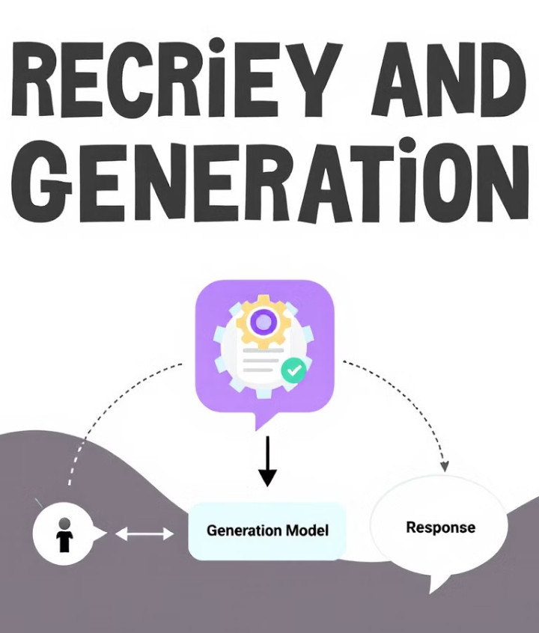




Integration of Retrieval and Generation
The seamless integration of retrieval and generation components is what sets RAG systems apart. This synergy allows the system to leverage vast knowledge bases while maintaining the flexibility and coherence of generative models. The process typically involves retrieving relevant information based on the user's query and then using this information to condition the language model's output.
One common approach is to concatenate the retrieved information with the user's query as input to the generative model. More sophisticated methods may involve attention mechanisms that allow the model to focus on different parts of the retrieved information dynamically. This integration enables the system to produce responses that are both informative and contextually appropriate.
User Query
Retrieval
The process begins with the user's input query or prompt.
Relevant information is fetched from the knowledge base using advanced retrieval techniques.
Context Preparation
Generation
Retrieved information is processed and combined with the original query.
The language model generates a response based on the prepared context.

Slide 7

Challenges in RAG Systems
While RAG systems offer significant advantages, they also present unique challenges. One major concern is the potential for hallucination, where the generative model produces plausible-sounding but factually incorrect information. This can occur when the retrieval component fails to provide relevant context or when the generative model overrelies on its pre-trained knowledge.
Another challenge is maintaining coherence between the retrieved information and the generated response. Ensuring that the system seamlessly incorporates external knowledge while maintaining a natural conversational flow requires careful design and tuning. Additionally, handling multi-turn conversations and maintaining context over extended interactions poses significant difficulties in RAG-based chatbots.
1
Hallucination Prevention
Developing techniques to reduce the generation of false or misleading information when relevant context is unavailable.
2
Coherence Maintenance
Ensuring smooth integration of retrieved information into generated responses without disrupting the natural flow of conversation.
3
Context Management
Effectively handling and updating context over multi-turn conversations to maintain relevance and consistency.
4
Scalability
Designing systems that can efficiently handle large-scale knowledge bases and high-volume queries in real-time applications.

Slide 8
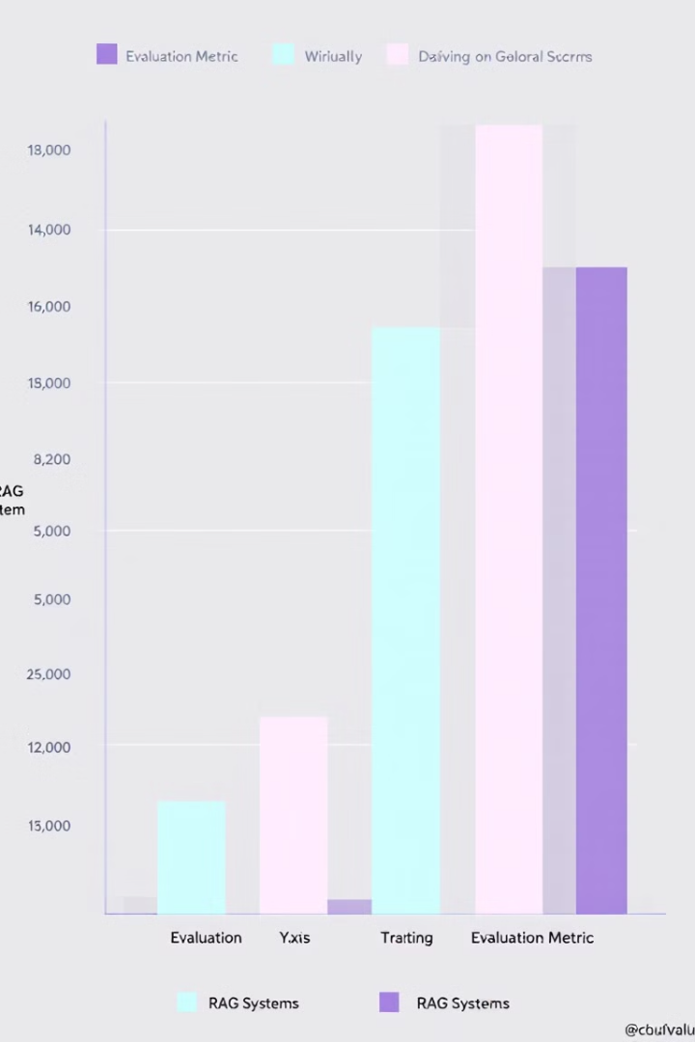
Evaluating RAG Systems
Evaluating the performance of RAG systems requires a multifaceted approach that considers both the retrieval and generation aspects. Traditional metrics like precision, recall, and F1 score are useful for assessing the retrieval component's effectiveness. For the generative aspect, metrics such as BLEU, ROUGE, and METEOR can provide insights into the quality of generated text.
However, these automated metrics often fall short in capturing the nuanced quality of responses in conversational systems. Therefore, human evaluation plays a crucial role, in assessing factors like relevance, coherence, and factual accuracy. A/B testing in real-world scenarios can also provide valuable insights into user satisfaction and system effectiveness.
Metric
Description
Component
Precision
Ratio of relevant retrieved documents to total retrieved
Retrieval
Recall
Ratio of relevant retrieved documents to total relevant documents
Retrieval
BLEU
Measures similarity between generated text and reference text
Generation
Human Evaluation
Assesses overall quality, relevance, and coherence
Both

Slide 9





Setting Up the Development Environment
Before diving into building a RAG chatbot, it's crucial to set up a robust development environment. This process involves installing necessary libraries, configuring virtual environments, and ensuring compatibility between different components. For our RAG chatbot, we'll primarily use Python and the transformers library by Hugging Face.
Start by creating a new virtual environment to isolate your project dependencies. Install the required libraries, including transformers, torch, and sentence transformers. It's also recommended to set up a Jupyter notebook environment for interactive development and experimentation. Ensure that you have sufficient computational resources, as working with large language models can be resource-intensive.
Python
Libraries
The primary programming language for developing the RAG chatbot.
Install key libraries like transformers, torch, and sentence-transformers.
Jupyter
Hardware
Set up a Jupyter notebook for interactive development and testing.
Ensure access to sufficient computational resources, preferably with GPU support.

Slide 10

Implementing the Retrieval Component
The retrieval component of our RAG chatbot is responsible for fetching relevant information based on user queries. We'll implement this using dense retrieval techniques, specifically leveraging sentence transformers for embedding generation. Start by preparing your knowledge base, which can be a collection of documents or a structured database.
Use a pre-trained sentence transformer model to generate embeddings for your knowledge-base documents. These embeddings will allow for efficient similarity searches. Implement a function that takes a user query, generates its embedding, and performs a similarity search against the knowledge base embeddings. The top-k most similar documents or passages will serve as the context for our generation step.
1
Prepare Knowledge Base
Organize and preprocess your documents or data sources.
2
Generate Embeddings
Use a sentence transformer to create embeddings for all documents.
3
Implement Search
Create a function for similarity search using cosine similarity or
other metrics.
4
Optimize Retrieval
Fine-tune the retrieval process for efficiency and accuracy.

Slide 11

Building the Generation Component
The generation component of our RAG chatbot is responsible for synthesizing coherent responses based on the retrieved information and user query. We'll use a pre-trained language model from the transformers library, such as GPT-2 or BART, as the foundation for our generator. The key is to effectively condition the model's output on both the user's query and the retrieved context.
Implement a function that takes the user's query and the retrieved context as input, concatenates them in a structured format, and feeds this to the language model. Use techniques like prompt engineering to guide the model's behavior. Experiment with different decoding strategies such as beam search or nucleus sampling to balance between diversity and coherence in the generated responses.
Model Selection
Choose an appropriate pre-trained
language model (e.g., GPT-2, BART)
based on your specific requirements.
Input Formatting
Develop a method to effectively
combine user queries and retrieved
context for input to the model.
Prompt Engineering
Design prompts that guide the model to
generate relevant and coherent responses.
Decoding Strategy
Implement and fine-tune decoding
methods like beam search or
nucleus sampling for optimal output.

Slide 12






Integrating Retrieval and Generation
The integration of the retrieval and generation components is the critical step that brings our RAG chatbot to life. This process involves creating a seamless pipeline that takes a user query, retrieves relevant information, and generates an appropriate response. The key challenge is to maintain coherence and relevance throughout this process.
Implement a main function that orchestrates the entire process. This function should call the retrieval component to fetch relevant context, then pass this context along with the original query to the generation component. Consider implementing a filtering mechanism to ensure that only the most relevant retrieved information is used. Additionally, you may want to add a post-processing step to refine the generated response, ensuring it aligns well with the retrieved information and the user's query.
User Input
Receive and preprocess the user's query.
Retrieval
Fetch relevant context from the knowledge base.
Context Preparation
Combine query and retrieved information.
Generation
Produce a response using the language model.
Post-processing
Refine the response for coherence and relevance.

Slide 13

Handling Multi-turn Conversations
To create a more engaging and contextually aware chatbot, it's essential to implement support for multi-turn conversations. This involves maintaining context across multiple user inputs and bot responses, allowing for more natural and coherent interactions. The challenge lies in balancing the retention of relevant past information with the incorporation of new context.
Implement a conversation history mechanism that stores previous exchanges. For each new user input, consider not just the immediate query but also relevant parts of the conversation history. Develop a strategy for selecting which historical information to include, possibly using a sliding window approach or relevance scoring. Update your retrieval and generation components to incorporate this historical context, ensuring that responses remain coherent and contextually appropriate across multiple turns.
Conversation History
Context Selection
Dynamic Updating
Implement a data structure to store and manage previous exchanges efficiently.
Develop algorithms to choose relevant historical context for each new query.
Continuously update the conversation context with new information from each exchange.

Slide 14

Optimizing Performance and Scalability
As you refine your RAG chatbot, it's crucial to focus on optimizing its performance and ensuring scalability for real-world applications. This involves addressing both computational efficiency and response quality. Start by profiling your code to identify bottlenecks, particularly in the retrieval and generation processes, which can be computationally intensive.
Implement caching mechanisms to store frequently accessed information or generated responses. Consider using approximate nearest neighbor search algorithms like FAISS for more efficient retrieval in large-scale knowledge bases. For the generation component, explore quantization techniques to reduce model size and inference time. If dealing with high traffic, implement a queue system to manage multiple concurrent requests effectively. Continuously monitor and tune your system based on performance metrics and user feedback.
1
Code Profiling
Use tools to identify performance bottlenecks in your
implementation.
2
Caching Strategies
Implement intelligent caching to reduce redundant
computations and database queries.
3
Efficient Retrieval
Utilize advanced algorithms like FAISS for fast similarity
search in large datasets.
4
Model Optimization
Explore techniques like quantization and pruning to
optimize the language model's performance.

Slide 15
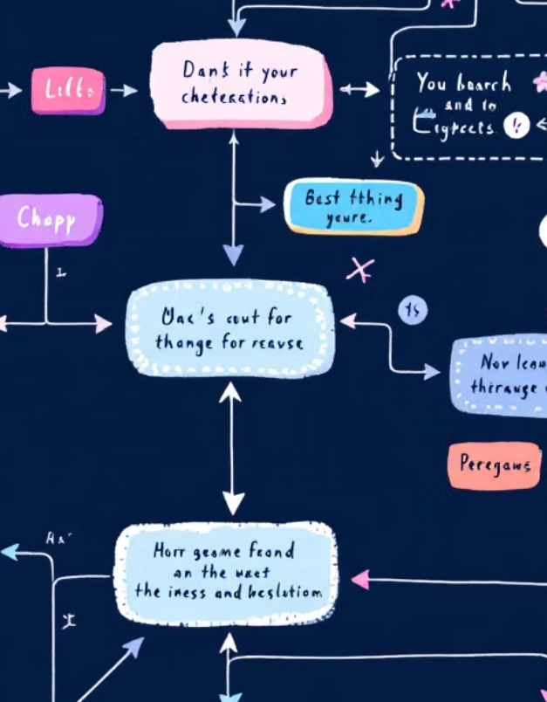
Future Directions and Advanced Techniques
As you continue to develop and refine your RAG chatbot, there are numerous advanced techniques and future directions to explore. One promising area is the integration of more sophisticated retrieval mechanisms, such as multi-hop reasoning or knowledge graph-based retrieval. These approaches can enhance the system's ability to handle complex queries that require connecting multiple pieces of information.
Another exciting direction is the incorporation of few-shot learning techniques, allowing the model to adapt to new domains or tasks with minimal additional training. Exploring ways to make RAG systems more interpretable and controllable is also crucial, especially for applications in sensitive domains. Finally, keep an eye on emerging research in areas like continual learning and meta-learning, which could potentially allow RAG systems to continuously improve and adapt over time without extensive retraining.
Advanced Retrieval
Explore multi-hop reasoning and knowledge graph-based retrieval for
handling complex queries.
Adaptive Learning
Implement few-shot learning techniques for quick adaptation to
new domains or tasks.
Continual Improvement
Investigate continual learning and meta-learning for ongoing system
enhancement.

